Slide 1
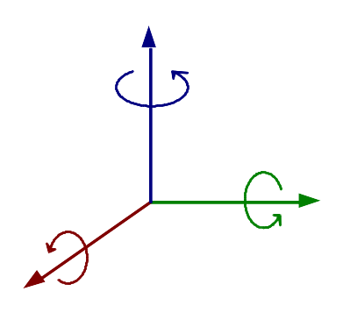
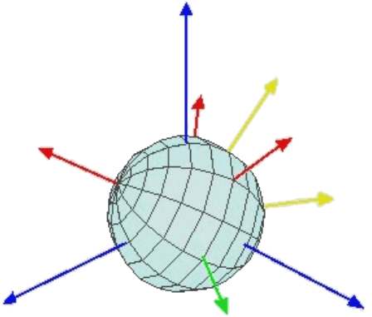
z
z
roll(1)
y’’
y’’’
x’’
z’
roll(3)
y’
yaw
x
y
x
x’
pitch(2)

